Slide 1
CIS5450 Final Project Presentation - Group 118
Aakash Jha, Thomas Ou, Kevin Jiang

Slide 2
UFC Analytics Engine
Goal: Use machine learning to predict MMA fight outcomes
Motivation: The UFC is not only entertaining, but it’s a fast-growing sport that is not only entertaining, but data-rich and unpredictable to most. Not only that, it’s backed by a multi-billion dollar betting industry engaging millions of fans worldwide.
What can we do?

Slide 3
Objective & Value Proposition
Objective: Analyze comprehensive fighter profile statistics and see what attributes are most predictive of winning fights using differential-based feature engineering approach.
Value Proposition: Beyond simply being able to predict outcomes, feature importance analysis can show what skills really matter most in MMA. Understanding whether reach differential, striking defense, or takedown accuracy is most predictive provides actionable insights that align with expert knowledge while potentially revealing undervalued attributes.
Real-World Applications:
Fighter Development
Matchmaking
Fan Engagement

Slide 4
Datasets
3 aggregated datasets
Target Variable
Cleaning
Handling missing data

Slide 5
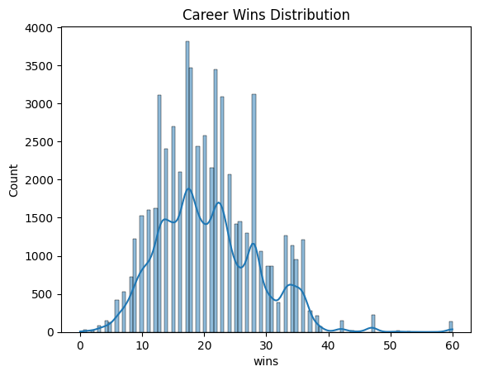
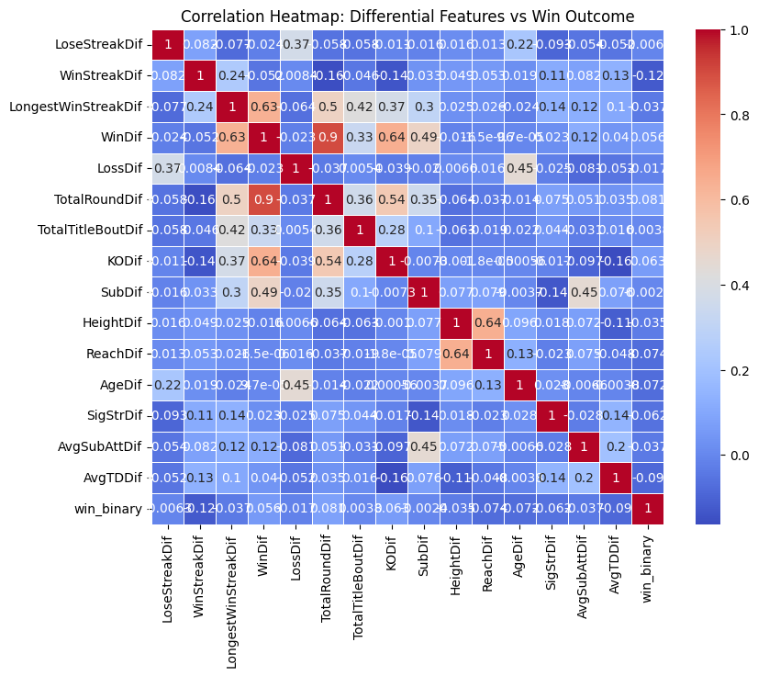
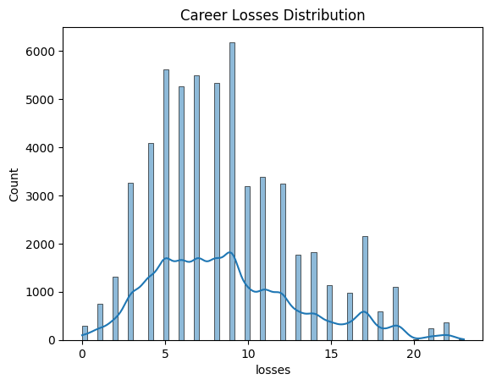
EDA

Slide 6
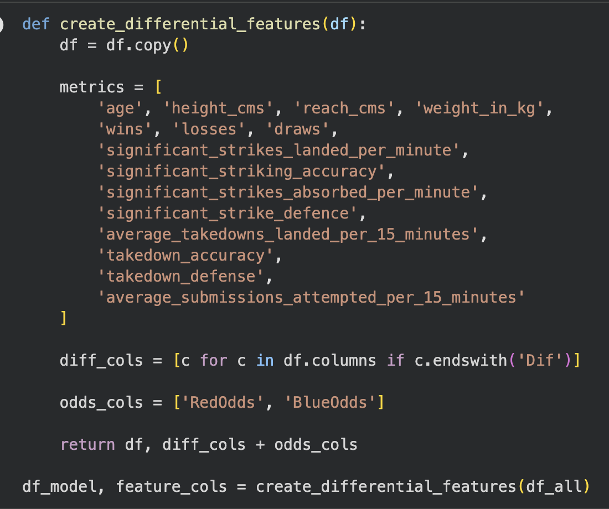
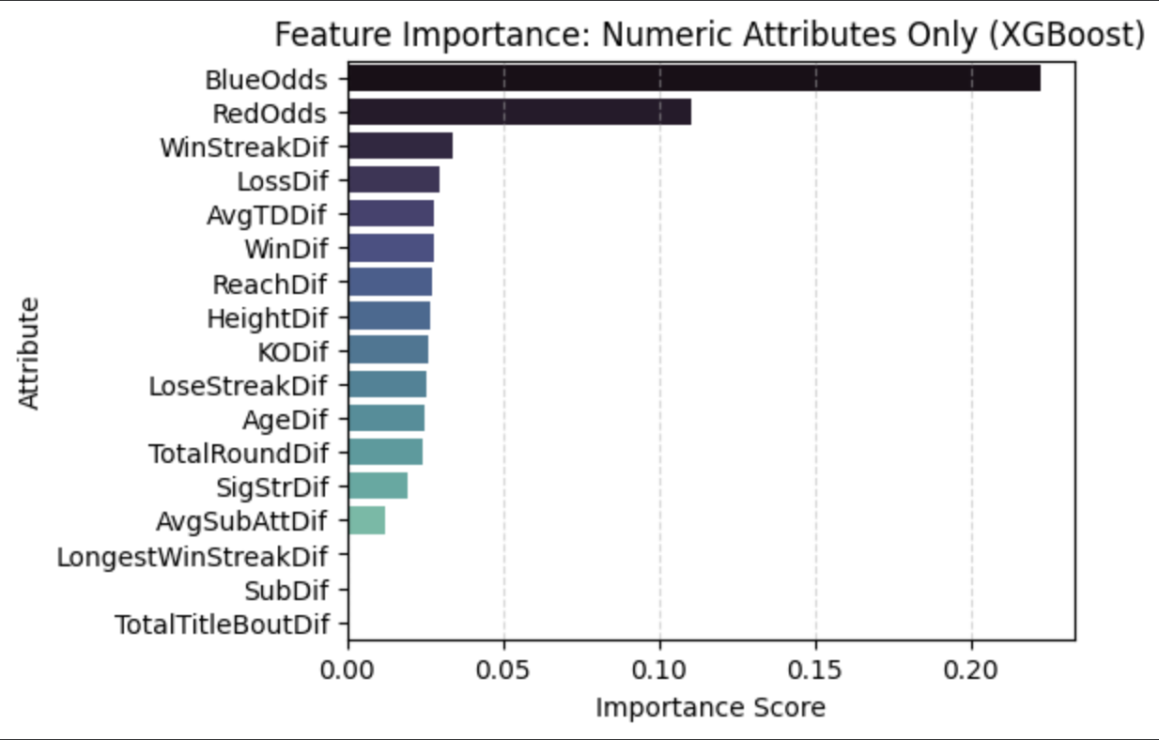
Why we use Differential Features

Slide 7
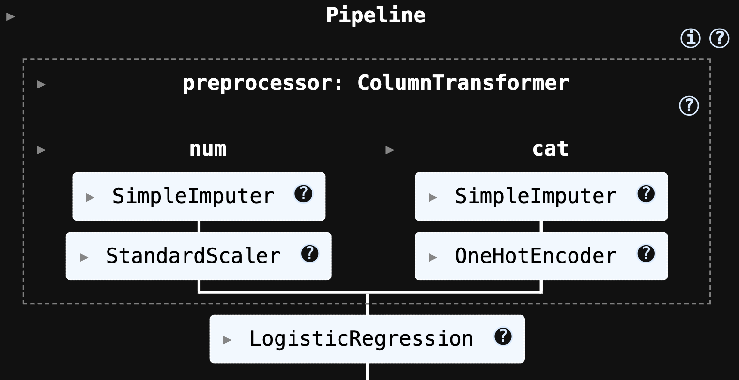
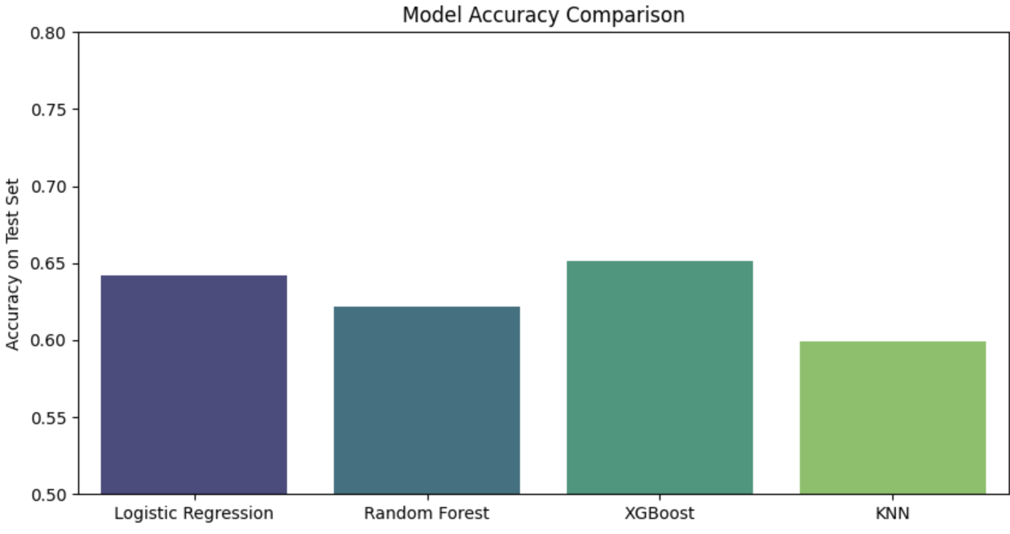
Modeling

Slide 8
Implications & Insights

Slide 9
Challenges, Limitations, Potential Future Work

